Slide 1

HOSPITAL MANAGEMENT
USING C- PROGRAM
Submitted to,
Lecturer Hema.M
Prepared by:
Sri Lakshmi Challa (RA2111052010013)
Illakiya K.S (RA2111052010010)

Slide 2
INTRODUCTION
The hospital management system (HMS) is an integrated software that handles different directions of clinic workflows.
Here, we are integrating physical management with software using C language.
The information of patients, disease-related information with appointment time, personal details etc. can be saved and accessed at anytime.
It is a very simple project based on file handling for storing the data.
This is a somewhat long but simple mini project in C programming language.

Slide 3
BRIEF INFORMATION ABOUT THE PROJECT
Hospital management system project is just a console application without graphics.
A Simple C Program For Hospital Management System creates an external file to store the user's data permanently.
Talking about the features of this Hospital Management System in C, the user can perform the CRUD ( Create, Read, Retrieve, Update and Delete) operations to it.

Slide 4
USE OF C-PROGRAM IN HOSPITAL MANAGEMENT
CRUD operations which means to “CREATE, READ, UPDATE and DELETE” are performed using C.
Like, add patient details by entering his/her name, disease name, phone number, cabin number, etc.
The user can also view and search all the available patient record details such as a patient’s name, age, disease, cabin number etc.. by giving any key inputs.
The user can also able to edit information as well as remove a patient's whole record or only his/her name, phone number, disease name, cabin number.

Slide 5
ALGORITHM
Initialized all the variables and declared variables type, size etc., used in the program
Displayed prompt statements using printf () to choose the required options.
Scanf() is used to let the user to provide inputs.
The choice of the user is read and respective action is performed by the executing the program.
The patient’s information is added, deleted, updated or edited as per the input given.
Written IF statements for conditional based logic.
For loops used in program to perform repetitive iterations.
Used gets() and puts() to read and fetch the data from input window and to display the data or string to the output window.
Return 0 to exit the program.

Slide 6
CODE
#include<stdio.h>
#include<string.h>
struct ad
{
char name[30];
char disease[30];
int cabin,phone,age;
} x[100];
int n,i,j=0,a=0,sum=0,g,flag,num;
void read();
void add();
void view();
void search();
void edit();
void del();
void show();
int main()
{
read();
int c,i,q;
printf("Simple Hospital Management System\n");
int m,n;

Slide 7
//making out the pattern for(m=1; m<=4; m++) { for(n=1; n<=5; n++) printf(" "); for(n=1; n<=m-1; n++) { printf(" "); } for(n=1; n<=4-m+1; n++) { if(n==4-m+1 || m==1 || m==4) printf("*"); else printf(" "); } for(n=1; n<=4-m+1; n++) { if(n==1 ||m==1 || m==4) printf("*"); else printf(" "); } printf("\n"); }

Slide 8
while(c!=6) { printf("**Enter your choice**\n\n1. Add Information\n2. View Information\n3. Search\n4. Edit Information\n5. Delete Information\n6. Exit\n\nOption="); scanf("%d",&c);//choice for option fflush(stdin);//making it clear if(c==1)//add { system("cls"); add(); } else if(c==2)//view { system("cls"); view(); } else if(c==3)//search { system("cls"); search(); } else if(c==4)//edit { system("cls"); edit(); }

Slide 9
else if(c==5)//delete { system("cls"); del(); } else if(c==6) { write(); return 0; } else { system("cls"); printf("\n\nInvalid input , try again by using valid inputs"); } printf("\n\n"); } } void add() { printf("\n\n"); printf("Already data inputed on the database =%d\n\n",num);//how many inputs printf("How many entry do you want to add=\n"); scanf("%d",&n); sum=n+num;

Slide 10
for(i=num,j=0; i<sum; i++) { printf("\n"); fflush(stdin); printf("Enter patient's Name = "); gets(x[i].name); fflush(stdin); printf("Enter disease = "); gets(x[i].disease); fflush(stdin); printf("Enter the age = "); scanf("%d",&x[i].age); fflush(stdin); printf("Enter cabin no = "); scanf("%d",&x[i].cabin); fflush(stdin); printf("Enter phone number = "); scanf("%d",&x[i].phone); fflush(stdin); printf("\n"); j++; a++; num++; } }

Slide 11
void view() { for(i=0; i<num; i++) { printf("\n"); printf("Serial Number=%d\n",i); printf("Name = "); puts(x[i].name); printf("Disease = "); puts(x[i].disease); printf("Cabin no = %d\nPhone number = 0%d\nAge=%d",x[i].cabin,x[i].phone,x[i].age); printf("\n\n"); } } void edit() { int q,p; fflush(stdin); printf("What do you want to edit ?\n"); printf("Enter your option\n"); printf("1.Name\n2.Disease\n3.Age\n4.Cabin\n5.Phone no.\n"); printf("Option="); scanf("%d",&q);//option if(q<=5) {

Slide 12
printf("Enter the serial no of that patient= (0 - %d)=",num-1); scanf("%d",&p);//serial number if(p<num) { if(q==1) { fflush(stdin); printf("Enter the new name="); gets(x[p].name); } else if(q==2) { fflush(stdin); printf("Enter the new Disease="); gets(x[p].disease); } else if(q==3) { fflush(stdin); printf("Enter the new Age="); scanf("%d",&x[p].age); }
else if(q==4)
{
fflush(stdin);
printf("Enter the new Cabin no=");
scanf("%d",&x[p].cabin);
}
else if(q==5)
{
fflush(stdin);
printf("Enter the new Phone no =");
scanf("%d",&x[p].phone);
}
}
else
{
printf("\n\nInvalid Serial \nTry Again !!\n\n");
}
}
else
{
printf("\n\nInvalid option\nTry Again!!\n\n");
}
}

Slide 13
void search() { int s,h,f; char u[100]; printf("By what do you want to search ?\n"); printf("1.Serial no.\n2.Name\n3.Disease\n4.Cabin no.\n5.Phone no.\n6.Age\n\nOption = "); scanf("%d",&h); if(h==1) { printf("Enter Serial number of the patient="); scanf("%d",&s); if(s<num) { printf("\n"); printf("Serial Number=%d\n",s); printf("Name = "); puts(x[s].name); printf("Disease = "); puts(x[s].disease); printf("Cabin no = %d\nPhone number = 0%d\nAge = %d",x[s].cabin,x[s].phone,x[s].age); printf("\n\n"); } else printf("\n\nNot Found\n\n");
}
else if(h==2)//problem is here.........
{
int f=1;
fflush(stdin);
printf("Enter your name=");
gets(u);
fflush(stdin);
for(g=0; g<num; g++)
{
if(strcmp(u,x[g].name)==0)
{
printf("\n");
printf("Serial Number=%d\n",g);
printf("Name = ");
puts(x[g].name);
printf("Disease = ");
puts(x[g].disease);
printf("Cabin no = %d\nPhone number = 0%d\nAge = %d",x[g].cabin,x[g].phone,x[g].age);
printf("\n\n");
f=0;
}
}
if(f==1)
printf("\nNot Found\n");

Slide 14
} else if(h==3) { int f=1; fflush(stdin); printf("Enter Disease = "); gets(u); fflush(stdin); for(g=0; g<num; g++) { if(strcmp(u,x[g].disease)==0) { printf("\n"); printf("Serial Number=%d\n",g); printf("Name = "); puts(x[g].name); printf("Disease = "); puts(x[g].disease); printf("Cabin no = %d\nPhone number = 0%d\nAge = %d",x[g].cabin,x[g].phone,x[g].age); printf("\n\n"); f=0; } } if(f==1) printf("\nNot Found\n");
}
else if(h==4)
{
int f=1;
printf("Enter Cabin number = ");
scanf("%d",&f);
for(g=0; g<num; g++)
{
if(f==x[g].cabin)
{
printf("\n");
printf("Serial Number=%d\n",g);
printf("Name = ");
puts(x[g].name);
printf("Disease = ");
puts(x[g].disease);
printf("Cabin no = %d\nPhone number = 0%d\nAge = %d",x[g].cabin,x[g].phone,x[g].age);
printf("\n\n");
f=0;
}
}
if(f==1)
printf("Not Found\n\n");

Slide 15
} else if(h==5) { int f=1; printf("Enter Phone number = "); scanf("%d",&f); for(g=0; g<num; g++) { if(f==x[g].phone) { printf("\n"); printf("Serial Number=%d\n",g); printf("Name = "); puts(x[g].name); printf("Disease = "); puts(x[g].disease); printf("Cabin no = %d\nPhone number = 0%d\nAge = %d",x[g].cabin,x[g].phone,x[g].age); printf("\n\n"); f=0; }
}
if(f==1)
printf("Not Found");
}
else if(h==6)
{
int f=1;
printf("Enter Age = ");
scanf("%d",&f);
for(g=0; g<num; g++)
{
if(f==x[g].age)
{
printf("\n");
printf("Serial Number=%d\n",g);
printf("Name = ");
puts(x[g].name);
printf("Disease = ");
puts(x[g].disease);
printf("Cabin no = %d\nPhone number = 0%d\nAge = %d",x[g].cabin,x[g].phone,x[g].age);
printf("\n\n");
f=0;
}

Slide 16
} if(f==1) printf("Not Found\n\n"); } else printf("\n\nInvalid input\n\n"); } void del() { int f,h; printf("Enter the serial number of the patient that you want to delete="); scanf("%d",&f); if(f<num) { printf("What do you want ?\n"); printf("1.Remove the whole record\n2.Remove Name\n3.Remove Disease\n4.Remove age\n5.Remove Cabin\n6.Remove phone number\nOption = "); scanf("%d",&h); if(h==1) { while(f<num) { strcpy(x[f].name,x[f+1].name); strcpy(x[f].disease,x[f+1].disease);

Slide 17
x[f].age=x[f+1].age; x[f].cabin=x[f+1].cabin; x[f].phone=x[f+1].phone; f++; } num--; } else if(h==2) { strcpy(x[f].name,"Cleared"); } else if(h==3) { strcpy(x[f].disease,"Cleared"); } else if(h==4) { x[f].age=0; } else if(h==5) { x[f].cabin=0; } else if(h==6) { x[f].phone=0;
}} else printf("\n\nInvalid Serial number\n");

Slide 18
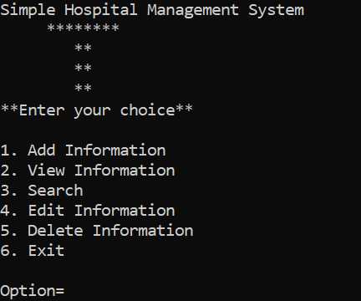
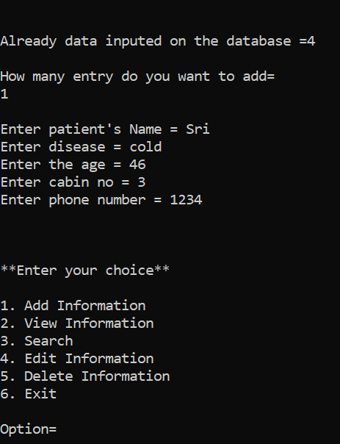
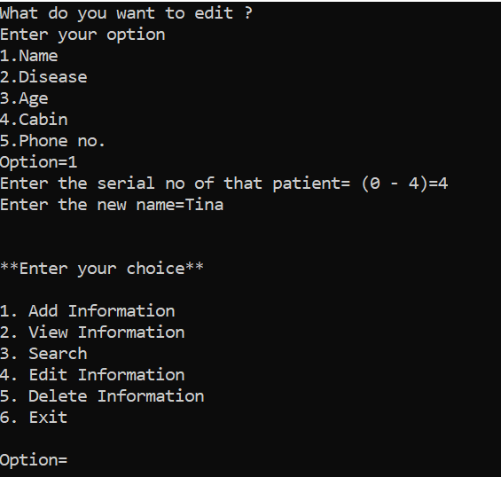
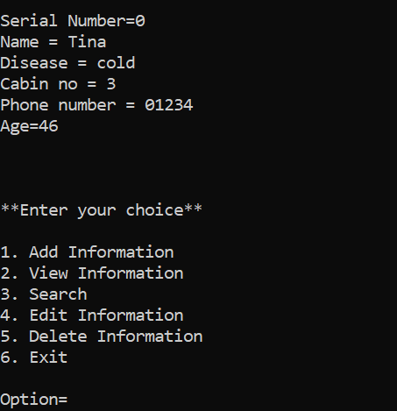
OUTPUT RESULTS OBATINED AFTER PROGRAM EXECUTION
Fig(1) : Output Screen
Fig(3) : Editing patient’s information (name)
Fig(4) : Record Entry Updated
Fig(2) : Adding patient’s information

Slide 19
RESULT AND CONCLUSION
Using this program patient’s information can be added, viewed, edited or deleted by selecting required option.
This is a feasible program to perform any kind of user actions that are useful mainly in Hospital Management.
It gives the user easy access to patient’s database to retrieve, fetch or change the information.

Slide 20
Thank you

